Slide 1

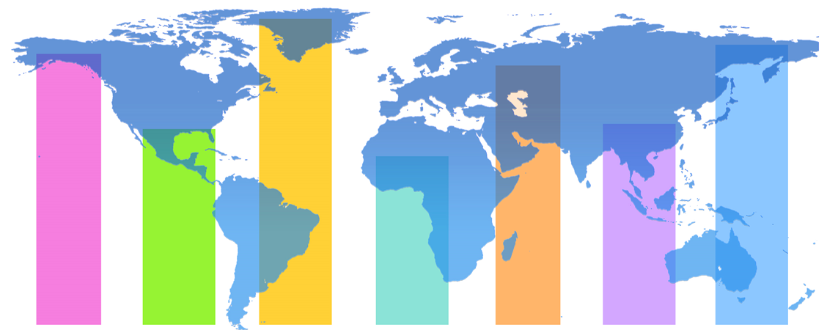
National Institute of Statistics of Rwanda
Demographic and Health Survey 2019-20
Key Indicators

Slide 2
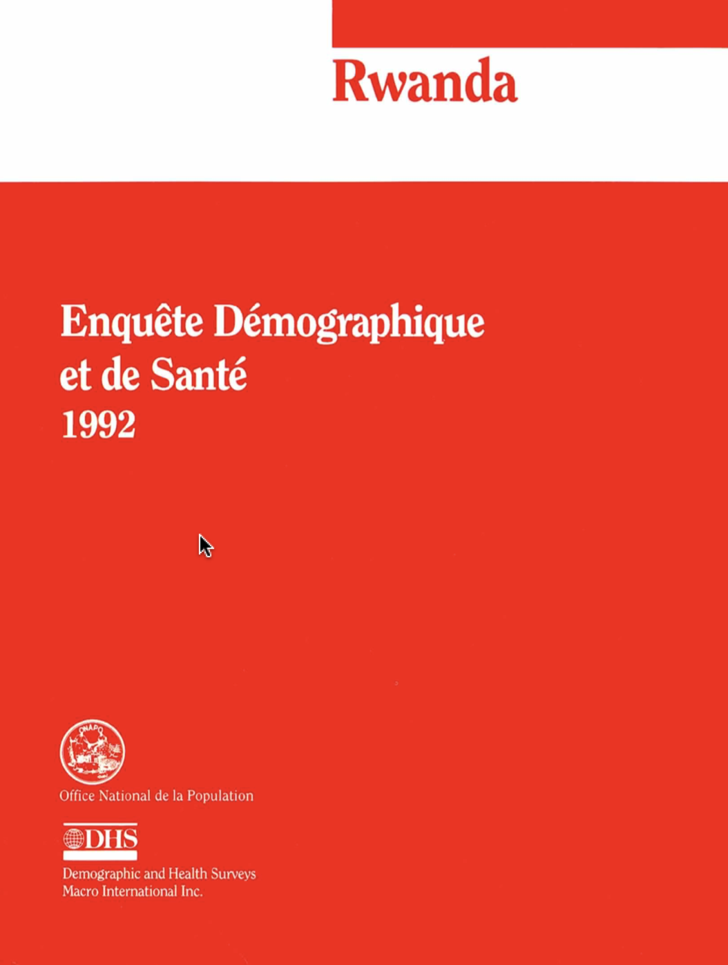

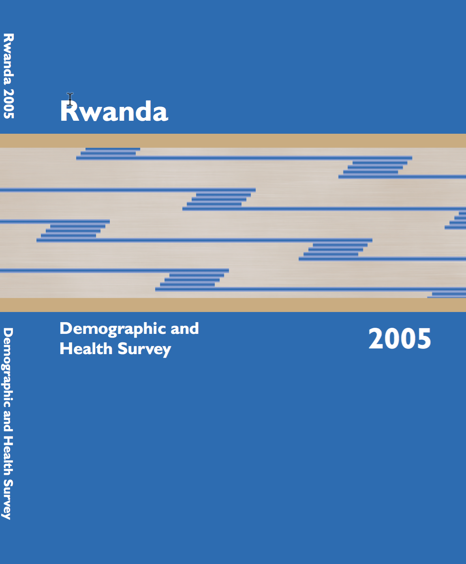
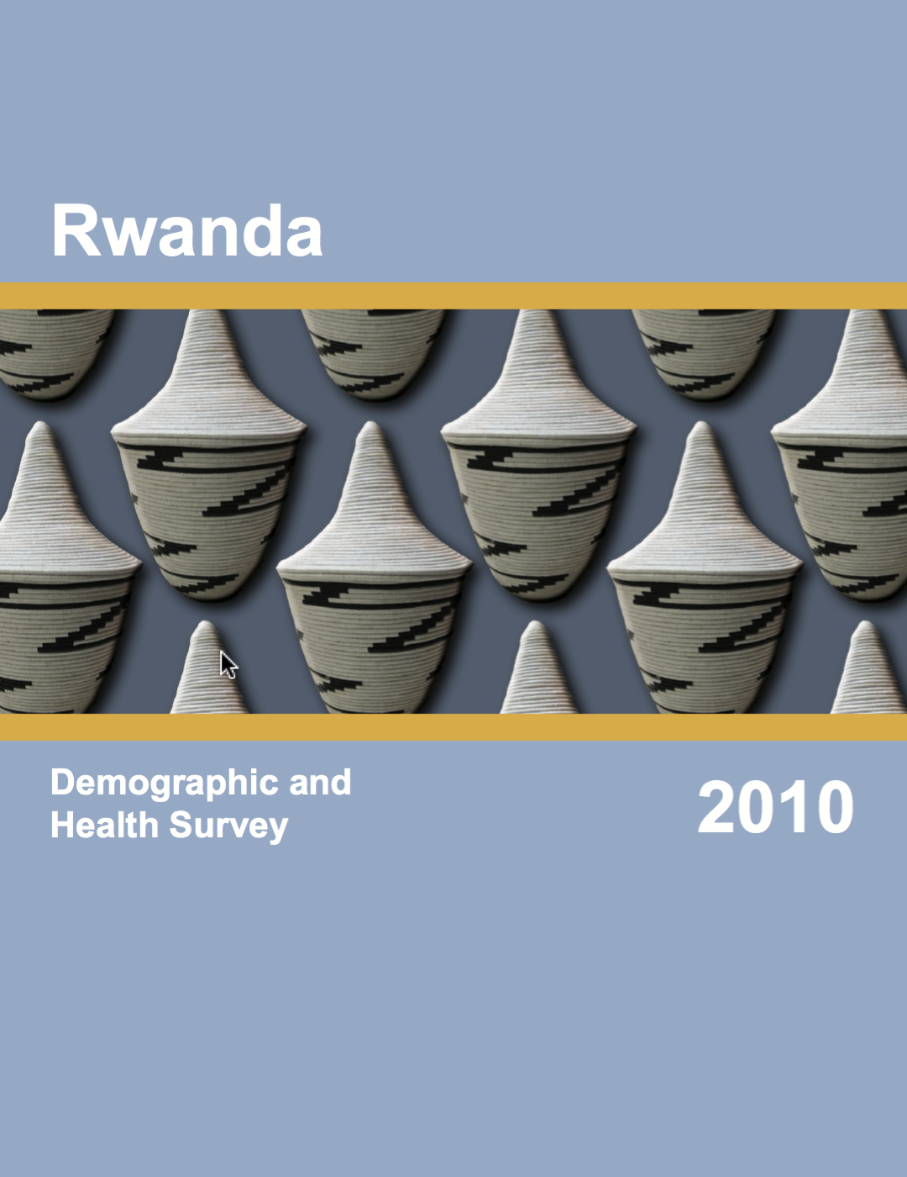
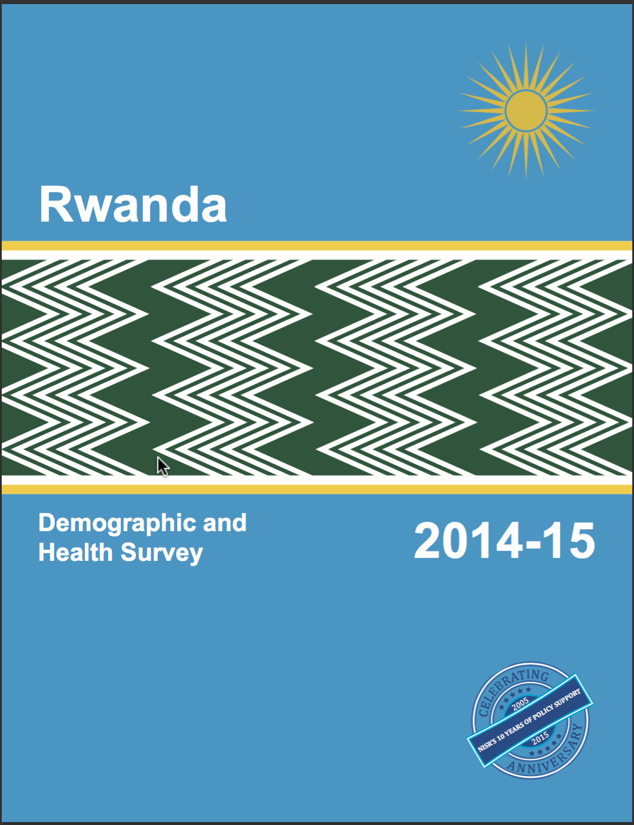
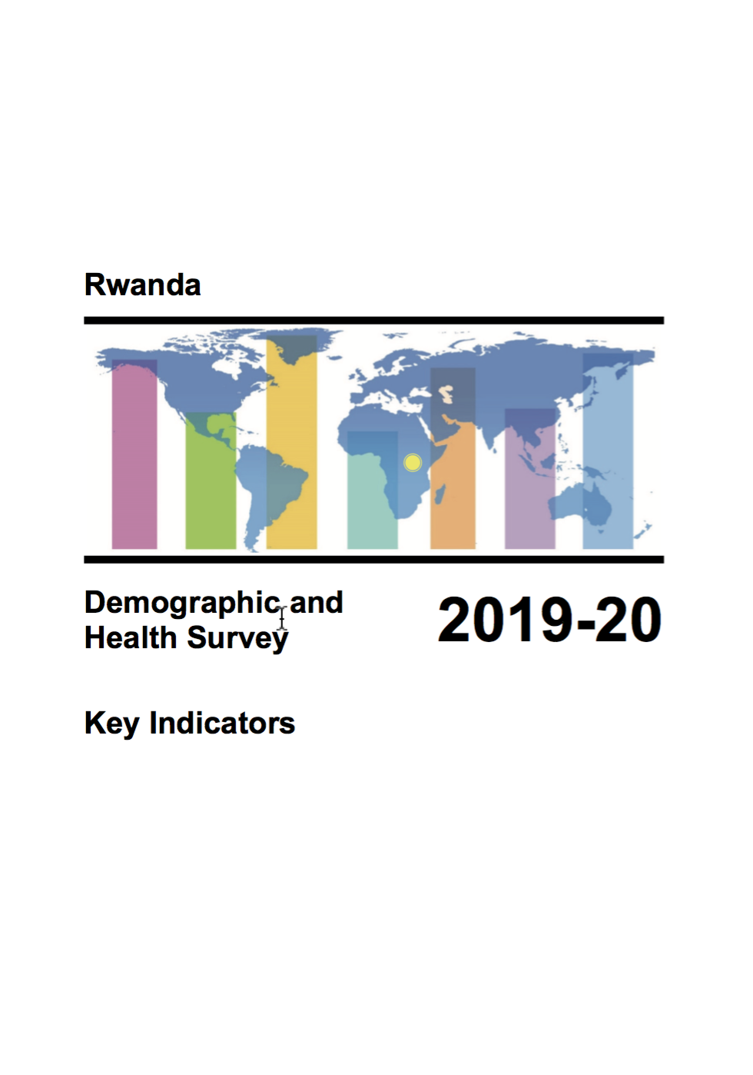

Slide 3
The Demographic and Health Survey among the most important surveys.
Focus: Health services, health outcomes and key demographics.
Very high response rates.
    Female response rate 99.7%.
    Male response rate 99.5%.

Slide 4
Trends in Childhood Vaccinations
Percent of children age 12-23 months with all basic vaccinations
Notes:
Vaccination coverage among children age 12-23 months has increased from 76% in 2000 to the current level of 96% in 2019-20.

Slide 5
Trends in ITN Ownership
Percent of households with at least one insecticide-treated net (ITN)
Notes:
ITN (Insecticide-treated mosquito net) ownership has increase since 2005, when only 15% of households owned at least one ITN. ITN ownership has stagnated between 2010 and 2015 before significantly reducing to 66% in 2019-2020.
*2007-08 RIDHS categorized ITNs as long-lasting insecticidal nets (LLIN).
RMIS: Rwanda Malaria Indicators Survey

Slide 6
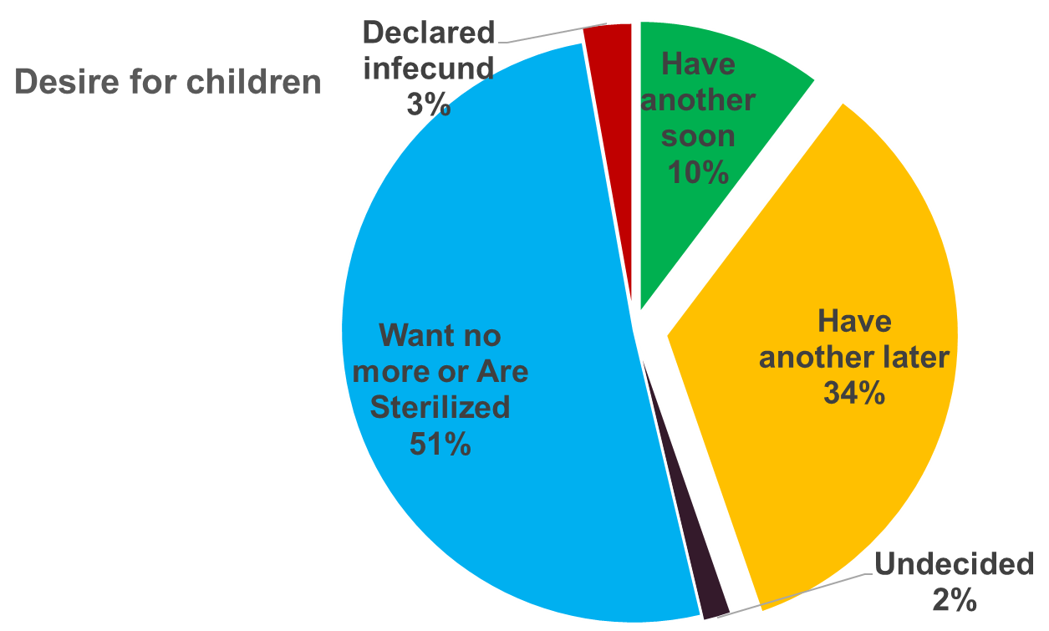
Fertility Preferences of Married Women
Percent of married women age 15-49 by desire for children
Only 10% of married women want to have a child soon.
Notes:
Half of married women want no more children or are sterilized. 1 in 10 married women want another child soon (within 2 years), while about 3 in 10 women want another child 2 or more years later.

Slide 7
Trends in Use of Contraception
Percent of married women age 15-49
Notes:
Use of any family planning has greatly increased from 13% in 2000 to 64% in 2019-20. Modern method contraceptive use has increased from 6% in 2000 to 58% in 2019-20.

Slide 8
Unmet Need For Family Planning
Percent of currently married women age 15-49
Notes:
Half of married women want no more children or are sterilized. 1 in 10 married women want another child soon (within 2 years), while about 3 in 10 women want another child 2 or more years later.

Slide 9
Trends in Maternal Health Care
Percent of live births in the five-year period before the survey
Notes:
*Skilled provider includes doctor, nurse/medical assistant, or midwife.
Since 2000 maternal health indicators have improved. Antenatal care (ANC) by a skilled provider is almost universal. Facility-based deliveries have greatly increased from 27% to 94% in 2019-20. Skilled assistance during delivery has tripled from 31% in 2000 to 93% in 2019-20.

Slide 10
Trends In Maternal Health Care
Percent with 4+ Antenatal care (ANC) visits

Slide 11
Fertility Trends:
Births per woman for the three-year period before the survey
Notes:
At current fertility levels, a woman in Rwanda will have an average of 4.1 children in her lifetime. Fertility has decreased from 6,2 births per woman in 1992 to 4,1 birth per woman in the almost past three decades, a decrease of 2.1 births per woman.

Slide 12
Fertility Trends by Area of Residence
Births per woman

Slide 13
Trends in Childhood Mortality
Deaths per 1,000 live births
Notes:
Infant mortality has declined by two-thirds from 107 deaths per 1,000 live births in 2000 to 33 (RDHS 2000 – RHS 2019-20). During the same time period, under-5 mortality has decreased from 196 to 45 deaths per 1,000 live births.

Slide 14
Trend in Maternal Mortality Ratio (MMR)
Maternal deaths per 100,000 live births
Notes:
Interpreting trends is difficult since every survey includes a sampling error. This means that the actual MMR in 2010-20 may be as high as 281 and as low as 125. This range is known as a confidence interval. If we look at the confidence intervals for the 2014-15 MMR, we can see that they range from 287-134. The confidence intervals between the MMRs for the two surveys overlap.

Slide 15
Trends in Nutritional Status of Children
Percent of children under 5
Stunted (too short for age)
Notes:
Overall, nutritional status of children has slightly improved since 2000 with declines in stunting, wasting, and underweight.

Slide 16









The survey was implemented by the National Institute of Statistics of Rwanda (NISR) in collaboration with the Ministry of Health (MOH).
Funding was provided by the Government of Rwanda, United States Agency for International Development (USAID), the United Nations Children Fund (UNICEF), the United Nations Population Fund (UNFPA), Enabel (Belgian Development Agency), UNWOMEN, and Centers for Disease Control and Prevention (CDC).
ICF provided technical assistance through The DHS Program.

Slide 17
Thank You Very Much For Your Attention
More details on: www.statistics.gov.rw

